Slide 1



Deep Learning by Design Using Tensorflow 2.0
Computer Vision Workshop - Training Foundation Version: Jan 2020
Repo: github.com/GoogleCloudPlatform/keras-idiomatic-programmer
twitter.com/andrewferlitsch

Slide 2
Training Foundation
Feed Forward and Backward Propagation
When training a model, one feeds data forward through the model and then backward propagates the losses to make updates to the model’s parameters (what the model is learning).
Let’s describe this in simpler terms. You have some training data which is representative of the target environment where the model will be deployed (i.e., sampling distribution of population distribution). The training data consists of examples. Each example has two parts:
the features (i.e., independent variables)
The corresponding labels (i.e., dependent variable).
The labels are also known as the ground truths -- “the correct answers”. Our goal is to train a model that once deployed, given examples without labels from the population (i.e., has never seen before), the model is generalized that it can accurately predict the label -- “the correct answer”. This later step is known as inference.

Slide 3
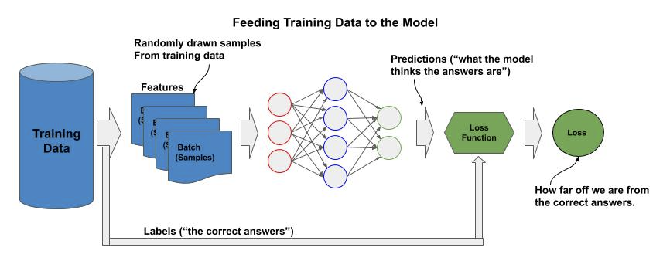
Training Foundation
Feeding
Feeding is the process of sampling batches from the training data and forward feeding the batches through the model, and calculating the loss at the output.
A batch can be one or more examples from the training data chosen at random. All the training data is split into batches, and typically each example will appear in only one batch.
The entire training data is fed multiple times to the model. Each time we feed the entire training data it is called an epoch; whereby, each epoch is a different random permutation into batches -- that is, no two epochs have the same ordering of examples.

Slide 4
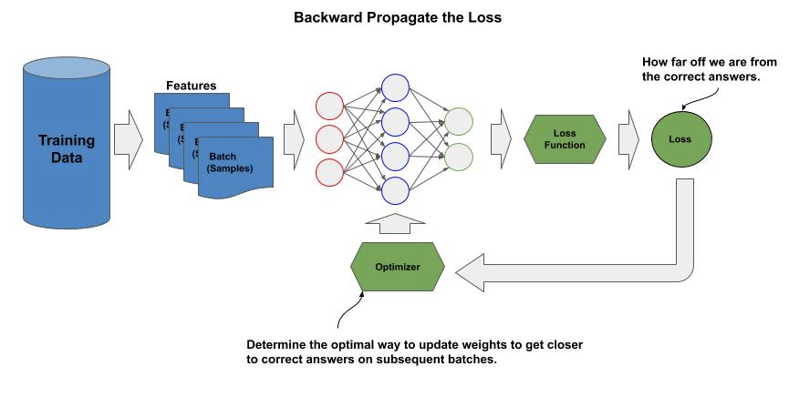
Training Foundation
Backward Propagation
After each batch of training data is forward fed through the model and the loss is calculated, the loss is backward propagated through the model. This means that we go layer by layer updating the model’s parameters, starting at the top layer (output) and move towards the bottom layer (input).
The optimizer is an implementation of gradient descent whose job is to update the parameters to minimize the loss (i.e., maximize getting closer to the correct answer) on subsequent batches.

Slide 5
Datasets
Curated Dataset
A dataset is a collection of examples that are large and diverse enough to be representative of the population that is being modeled (i.e., sampling distribution).
When a dataset meets this definition and is cleaned (i.e., not noisy) and in a formatted ready for machine learning training, we referred to it as a curated dataset.

Slide 6
Datasets
Dataset Splitting
The next step is to split it into examples that will be used for training and those used for test (also referred to as evaluation or holdout). We train the model with the portion of the dataset that is the training data.
If we assume the training data is a good sampling distribution (i.e., representative of the population distribution), then the accuracy only on the training data should reflect the accuracy when deployed to the real-world predictions on examples from the population not seen by the model during training.
But how does one know whether this is true before we deploy the model?
Hence the purpose for the test (holdout) data. We set aside a portion of the dataset that we will test against once the model is done training and see if we get a comparable accuracy.

Slide 7
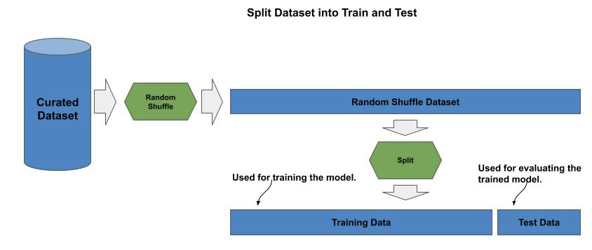
Datasets
Train and Test Sets
Historically, the rule of thumb has been 80/20, 80% for training and 20% for test.
What is important is that we assume our dataset is sufficiently large enough, that if we split it into 80% and 20% and the examples are randomly chosen that both datasets will be good sampling distributions which are representative of the population distribution that the model will make predictions (inference) from once deployed.

Slide 8
Built-in Datasets
MNIST Dataset
The TF.Keras builtin datasets have a load_data() method. This method loads into memory the dataset already randomly shuffled and pre-split into train and test data. For both train and test, the data is further separated into the features -- the image data in this case, and the corresponding labels.
It is a common convention to refer to the features and labels for train and test as (x_train, y_train) and (x_test, y_test) respectively.
from tensorflow.keras.datasets import mnist # builtin dataset is automatically randomly shuffled and pre-split into train and # test data. (x_train, y_train), (x_test, y_test) = mnist.load_data()

Slide 9
Built-in Datasets
Build Model for MNIST
In the code example below, we start by flattening the image input 28 x 28 into a 1D vector using the layer Flatten(), which is then followed by two hidden Dense() layers of 512 nodes each, each using the convention of a ‘relu’ activation function, and finally the output layer is a Dense() layer with ten nodes, one for each digit. Since this is a multi-class classifier, the activation function for the output layer is a ‘softmax’.
Next, we compile the model for the convention for multi-class classifiers using ‘categorical_crossentropy’ for the loss and ‘adam’ for the optimizer.
from tensorflow.keras import Sequential from tensorflow.keras.layers import Flatten, Dense model = Sequential() model.add(Flatten(input_shape=(28, 28))) model.add(Dense(512, activation='relu')) model.add(Dense(512, activation='relu')) model.add(Dense(10, activation='softmax')) model.compile(loss='categorical_crossentropy', optimizer='adam', metrics=['acc'])

Slide 10
Built-in Datasets
Train Model for MNIST
The basic method to train this model with this dataset is to use the fit() method. We will pass as parameters the training data (x_train, y_train).
When you run the above you will see an error message.
What went wrong?
model.fit(x_train, y_train)
ValueError: You are passing a target array of shape (60000, 1) while using as loss `categorical_crossentropy`. `categorical_crossentropy` expects targets to be binary matrices (1s and 0s) of shape (samples, classes).

Slide 11
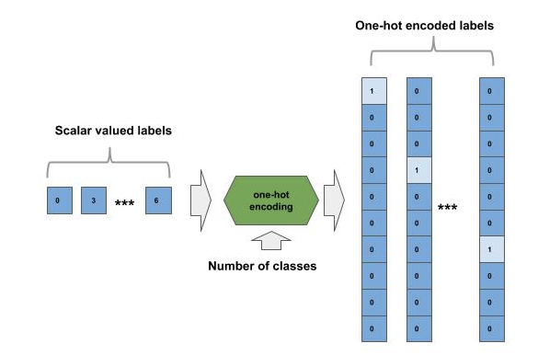
One-Hot Encoding
One-Hot Encoding
In this case, we need to convert the scalar valued labels into 10 element vectors with a one in the corresponding index. This is known as one-hot encoding.
This is an issue with the loss function we choose. It will compare the difference between each output node and corresponding output expectation.

Slide 12
One-Hot Encoding
One-Hot Encoding
Let’s fix our above example by first importing the to_categorical() function from TF.Keras and then use it to convert the scalar value labels to one-hot encoded labels.
Note how we pass the value 10 to to_categorical() to indicate the size of the one-hot encoded labels (number of classes).
Now when we run this, your output will look something like:
from tensorflow.keras.utils import to_categorical y_train = to_categorical(y_train, 10) y_test = to_categorical(y_test, 10) model.fit(x_train, y_train)
60000/60000 [==============================] - 5s 81us/sample - loss: 1.3920 - acc: 0.9078

Slide 13
One-Hot Encoding
One-Hot Encoding
The compile() method has one-hot encoding built into it.
We just change the loss function from ‘categorical_crossentropy’ to ‘sparse_categorical_crossentry’.
After the tenth epoch, you should see an accuracy on the training data around 97%.
model.compile(loss='sparse_categorical_crossentropy', optimizer='adam', metrics=['acc']) from tensorflow.keras.datasets import mnist (x_train, y_train), (x_test, y_test) = mnist.load_data() model.fit(x_train, y_train, epochs=10)
Epoch 10/10 60000/60000 [==============================] - 5s 81us/sample - loss: 0.0187 - acc: 0.9943

Slide 14
Normalization
Problem with Large Numbers
The image data loaded by the mnist() module is in raw format. That means, that each image is a 28 x 28 matrix of integer values between 0 .. 255. If you were to inspect the parameters (weights and biases) within a trained model, they are very small numbers, typically between -1 and 1.
The problem we have above is that the input values are substantially larger (i.e., upto 255) which will produce large numbers initially as they are multiplied through the layers. This will result in taking longer for the parameters to “learn” their optimal values -- if they learn them at all.

Slide 15
Normalization
Squashing
We can increase the speed at which the parameters learn the optimal values and increase our chances of convergence by squashing the input values into a smaller range.
One simple way to squash the values is to squash them proportionally into a range between 0 and 1. We can do this by simply dividing each value by 255.
Higher accuracy (99.4%) with normalization:
(x_train, y_train), (x_test, y_test) = mnist.load_data() x_train = (x_train / 255.0).astype(np.float32) x_test = (x_test / 255.0).astype(np.float32) model.fit(x_train, y_train, epochs=10)
Epoch 10/10 60000/60000 [==============================] - 5s 81us/sample - loss: 0.0187 - acc: 0.9943

Slide 16
Normalization
Squashing
There are a variety of methods for squashing the input data beyond the normalization method we showed above. For example, some ML practitioners prefer to squash the input values between -1 and 1 (instead of 0 and 1), so that the values are centered at zero.
x_train = ((x_train / 127.5) - 1).astype(np.float32)

Slide 17
Normalization
Standardization
Another method called standardization is considered to give a better result, but requires a pre-analysis (scan over) the entire input data to find:
The mean and standard deviation of the input data,
Then centering the data at the mean of the full distribution of the input data, and then
Squash the values between +/- one standard deviation.
import numpy as np mean = np.mean(x_train) std = np.std(x_train) x_train = ((x_train - mean) / std).astype(np.float32)

Slide 18
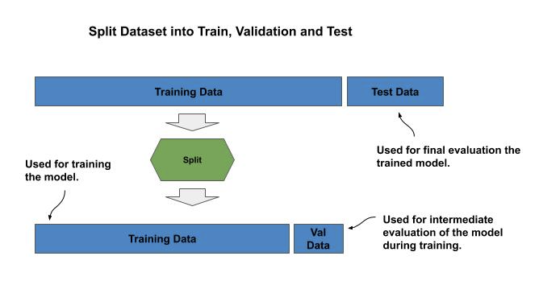
Validation Data
Validation Split
A small portion of the training data that is set aside, which we call the validation data. We won’t train the model with the validation data. Instead, after each epoch we use the validation to estimate the likely result on the test data.

Slide 19
Validation Data
Validation Split
Use 10% of training data for validation in example of training a model for CIFAR-10:
from tensorflow.keras.datasets import cifar10 (x_train, y_train), (x_test, y_test) = cifar10.load_data() x_train = (x_train / 255.0).astype(np.float32) x_test = (x_test / 255.0).astype(np.float32) model.fit(x_train, y_train, epochs=15, validation_split=0.1)

Slide 20
Validation Data
Overfitting
Below is the output after running 15 epochs. You can see that after the fourth epoch, the training and evaluation accuracy are essentially the same. But after the fifth epoch, we start to see them spread apart (65% vs 61%). By the 15th epoch, the spread is very large (74% vs 63%). Our model clearly started overfitting around the fifth epoch.
Train on 45000 samples, validate on 5000 samples … Epoch 4/15 45000/45000 [==============================] - 8s 184us/sample - loss: 1.0444 - acc: 0.6386 - val_loss: 1.0749 - val_acc: 0.6374 Epoch 5/15 45000/45000 [==============================] - 9s 192us/sample - loss: 0.9923 - acc: 0.6587 - val_loss: 1.1099 - val_acc: 0.6182 ... Epoch 15/15 45000/45000 [==============================] - 8s 180us/sample - loss: 0.7256 - acc: 0.7498 - val_loss: 1.1019 - val_acc: 0.6382

Slide 21
Numerical Stability
Going Deeper with Layers
Going deeper with layers can lead to instability in the model, without addressing the issues with techniques such as identity links and batch normalization.
For example, many of the values we are matrix multiplying are small numbers less than 1. Multiply two numbers less than one and you get an even smaller number.
Numbers get so small that the hardware can’t represent the value anymore, referred to as a vanishing gradient.
The parameters maybe too close to distinguish from each other, or the opposite spread too far apart.

Slide 22
Numerical Stability
Going Deeper with Layers
The code example below demonstrates this by using a 40-layer DNN absent of methods to protect from numerical instability as we go deeper in layers.
Model = Sequential() model.add(Dense(64, activation='relu', input_shape=(28, 28)) for _ in range(40): model.add(Dense(64, activation='relu')) model.add(Dense(10, activation='softmax')) model.compile(loss='sparse_categorical_crossentropy', optimizer='adam', metrics=['acc'])

Slide 23
Numerical Stability
Going Deeper with Layers
In the first three epochs we have consistent increase in accuracy in training and evaluation data, as well as consistent decrease in corresponding loss. But afterwards it becomes erratic -- hence the model is numerical unstable.
Epoch 1/10 54000/54000 [==============================] - 9s 161us/sample - loss: 1.4461 - acc: 0.4367 - val_loss: 0.8802 - val_acc: 0.7223 Epoch 2/10 54000/54000 [==============================] - 7s 134us/sample - loss: 0.8054 - acc: 0.7202 - val_loss: 0.7419 - val_acc: 0.7727 Epoch 3/10 54000/54000 [==============================] - 7s 136us/sample - loss: 0.8606 - acc: 0.7530 - val_loss: 0.6923 - val_acc: 0.8352 Epoch 4/10 54000/54000 [==============================] - 8s 139us/sample - loss: 0.8743 - acc: 0.7472 - val_loss: 0.7726 - val_acc: 0.7617 Epoch 5/10 54000/54000 [==============================] - 8s 139us/sample - loss: 0.7491 - acc: 0.7863 - val_loss: 0.9322 - val_acc: 0.7165 Epoch 6/10 54000/54000 [==============================] - 7s 134us/sample - loss: 0.9151 - acc: 0.7087 - val_loss: 0.8160 - val_acc: 0.7573 Epoch 7/10 54000/54000 [==============================] - 7s 135us/sample - loss: 0.9764 - acc: 0.6836 - val_loss: 0.7796 - val_acc: 0.7555 Epoch 8/10 54000/54000 [==============================] - 7s 134us/sample - loss: 0.8836 - acc: 0.7202 - val_loss: 0.8348 - val_acc: 0.7382 Epoch 9/10 54000/54000 [==============================] - 8s 140us/sample - loss: 0.7975 - acc: 0.7626 - val_loss: 0.7838 - val_acc: 0.7760 Epoch 10/10 54000/54000 [==============================] - 8s 140us/sample - loss: 0.7317 - acc: 0.7719 - val_loss: 0.5664 - val_acc: 0.8282

Slide 24
Convergence
Overtraining
If we overtrain the neural network, the following can happen:
The neural network becomes overfitted to the training data, showing increasing accuracy on the training data, but degrading accuracy on the test data.
In deeper neural networks, the layers will learn in a non-uniform manner and have different convergence rates. Thus, as some layers are working towards convergence, others may have convergence and thus start diverging.
Continued training may cause the neural network to pop out of one local optima and start converging on another local optima that is less accurate.

Slide 25
Convergence
Overtraining on Simple Covnet
Below are the stats for the first six epochs of a simple covnet on CIFAR-10. With each pass there is a steady reduction in loss, which means the neural network is getting closer to fitting the data. Additionally, the accuracy on the training data is going up from 52.35% to 87.4% and on the validation data from 63.46% to 67.14%.
Train on 45000 samples, validate on 5000 samples Epoch 1/20 45000/45000 [==============================] - 53s 1ms/sample - loss: 1.3348 - acc: 0.5235 - val_loss: 1.0552 - val_acc: 0.6346 Epoch 2/20 45000/45000 [==============================] - 52s 1ms/sample - loss: 0.9527 - acc: 0.6667 - val_loss: 0.9452 - val_acc: 0.6726 Epoch 3/20 45000/45000 [==============================] - 52s 1ms/sample - loss: 0.7789 - acc: 0.7252 - val_loss: 0.9277 - val_acc: 0.6882 Epoch 4/20 45000/45000 [==============================] - 419s 9ms/sample - loss: 0.6328 - acc: 0.7785 - val_loss: 0.9324 - val_acc: 0.6964 Epoch 5/20 45000/45000 [==============================] - 53s 1ms/sample - loss: 0.4855 - acc: 0.8303 - val_loss: 1.0453 - val_acc: 0.6860 Epoch 6/20 45000/45000 [==============================] - 51s 1ms/sample - loss: 0.3575 - acc: 0.8746 - val_loss: 1.2903 - val_acc: 0.6714

Slide 26
Convergence
Overtraining on Simple Covnet
Let’s now look at epochs 11 thru 20. You can see that we’ve hit 98.46% on the training data, which means we are tightly fitted to the training data. On the other hand, our accuracy on the validation data plateaued at 66.58%. Thus, after six epochs, there was no improvement from continued training, and we can conclude that by epoch 7 the model was overfitted to the training data.
Epoch 11/20 45000/45000 [==============================] - 52s 1ms/sample - loss: 0.0966 - acc: 0.9669 - val_loss: 2.1891 - val_acc: 0.6694 Epoch 12/20 45000/45000 [==============================] - 50s 1ms/sample - loss: 0.0845 - acc: 0.9712 - val_loss: 2.3046 - val_acc: 0.6666 ….. Epoch 20/20 45000/45000 [==============================] - 1683s 37ms/sample - loss: 0.0463 - acc: 0.9848 - val_loss: 3.1512 - val_acc: 0.6658

Slide 27
Checkpointing
Checkpointing
Checkpointing is periodically saving the learned model parameters and current hyperparameter values during training. There are two reasons for doing this:
To be able to resume training of a model without restarting the training (i.e., where it left off).
Identify a past point training that the model gave the best results.

Slide 28
Checkpointing
Setting a Checkpoint
By default, checkpointing occurs at the end of an epoch.
The parameter filepath is the file path of where to write the checkpoint to. The filepath can either be a complete file path or a formatted file path. In the former case, the checkpoint file would be overwritten each time. In the case below, we used the format syntax `epoch:02d’ to generate a unique file for each checkpoint, based on the epoch number. For example, if it’s the third epoch, the file would be ‘mymodel-03.ckpt’.
from tensorflow.keras.callbacks import ModelCheckpoint # Create a unique checkpoint file per checkpoint using the formatting option {epoch:02d} filepath = "mymodel-{epoch:02d}.ckpt" # Create a checkpoint checkpoint = ModelCheckpoint(filepath) # Train the model and use the callbacks parameter to enable the checkpoint model.fit(x_train, y_train, epochs=epochs, callbacks=[checkpoint])

Slide 29
Checkpointing
Restore from a Checkpoint
A model can then be subsequently restored from a checkpoint using the load_model() method:
from tensorflow.keras.models import load_model # restore a model from a saved checkpoint model = load_model('mymodel-03.ckpt')

Slide 30
Checkpointing
Periodic Checkpointing
For models with larger number of parameters and/or number of epochs, one may choose to save a checkpoint on every nth epoch (e.g., every 4th epoch) with the parameter period. In the code example below, a checkpoint is saved on every 4th epoch:
# Create a checkpoint for every 4th epoch checkpoint = ModelCheckpoint(filepath, period=4) # Train the model and use the callbacks parameter to enable the checkpoint model.fit(x_train, y_train, epochs=epochs, callbacks=[checkpoint])

Slide 31
Checkpointing
Save Best
One may choose to save the current best checkpoint with the parameters save_best_only=True and the parameter monitor to the measurement to base the decision on. Examples:
If the parameter monitor is set to val_acc, it will only write a checkpoint if the valuation accuracy is higher than the last saved checkpoint.
If the parameter is set to val_loss, it will only write a checkpoint if the valuation loss is lower than the last saved checkpoint.
# Create a checkpoint for every 4th epoch checkpoint = ModelCheckpoint(filepath, save_best_only=True, monitor='val_acc') # Train the model and use the callbacks parameter to enable the checkpoint model.fit(x_train, y_train, epochs=epochs, callbacks=[checkpoint])

Slide 32
Early Stopping
Early Stopping
An early stop is setting a condition upon which training is terminated earlier than the set limits (e.g., number of epochs).
This is generally set to conserve resources and/or prevent overtraining when a goal objective is reached, such as:
level of accuracy,
convergence on evaluation loss, etc.
For example, one might set a training for 20 epochs, which average 30 minutes each --for a total of 10 hours. But if the objective is met after 8 epochs, it would be ideal to terminate the training, saving 6 hours of resources.

Slide 33
Early Stopping
Setting an Early Stop
In the code example below, training will be stopped early if the valuation loss stops reducing from the previous epoch:
from tensorflow.keras.callbacks import EarlyStopping # set an early stop (termination of training) when the valuation loss has stopped # reducing (default setting). earlystop = EarlyStopping(monitor='val_loss') # Train the model and use early stop to stop training early if the valuation loss # stops decreasing model.fit(x_train, y_train, epochs=epochs, callbacks=[earlystop])

Slide 34
Early Stopping
Setting an Early Stop
One can alternately monitor the valuation accuracy with the parameter setting monitor=”val_acc”. There are some additional parameters for fine tuning to prevent inadvertent early stop, such as on a saddle point where more training will overcome.
The parameter patience specifies a minimum number of epochs without improvement before early stop, and
The parameter min_delta specifies a minimum threshold to determine if the model improved or not.
# set an early stop (termination of training) when the valuation loss has stopped # reducing for three epochs. earlystop = EarlyStopping(monitor='val_loss', patience=3) # Train the model and use early stop to stop training early if the valuation loss # stops decreasing model.fit(x_train, y_train, epochs=epochs, callbacks=[earlystop])

Slide 35
Hyperparameters
Parameters vs. Hyperparameters
Parameters - These are the parameters (weights and biases) which are “learned” during training and stay with the model after it is trained.
Hyperparameters - These are the parameters (e.g., epochs, learning rate) used to train the model, but are not part of the model after it is trained.

Slide 36
Hyperparameters
Hyperparameters
Hyperparameters are used to improve the training of the model, such as for:
How long does it take to train the model?
How fast does the model converge?
Does it find the global optima?
How accurate is the model?
How overfitted is the model?

Slide 37
Hyperparameters
Epochs
The most basic hyperparameter is the number of epochs -- though this is now being more commonly replaced with steps. The epochs hyperparameter is the number of times you will pass the entire training data through the neural network during training.
Early presumptions on training were that the more times you feed the training data into the model, the better the accuracy. What we’ve found, particularly on larger and more complex networks, is that there is a point where the accuracy will degrade.

Slide 38
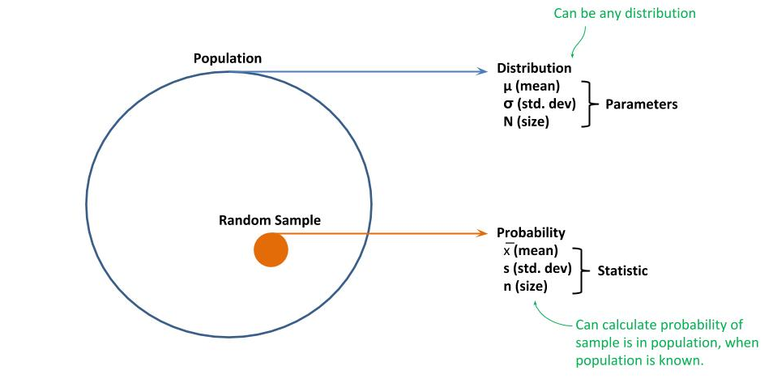
Hyperparameters
Steps
Another way to improve accuracy and reduce training time is by changing the sampling distribution of the training dataset.
For epochs, we think of a sequential draw of batches from our training data. Even though we randomly shuffle the training data at the start of each epoch, the sampling distribution is still the same.
Let’s now think of the entire population of what we want to recognize. In statistics, we call this the population distribution.

Slide 39
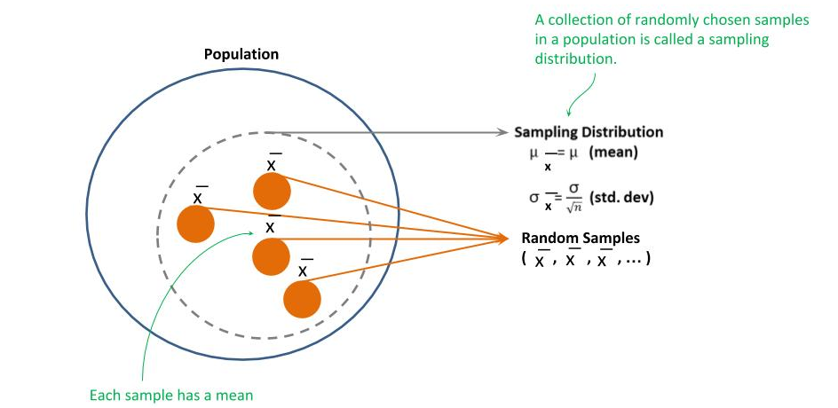
Hyperparameters
Steps
But we will never have a dataset that is the actual entire population distribution. Instead, we have some samples, which we refer to as a sampling distribution of the population distribution, as depicted in the figure below.

Slide 40
Hyperparameters
Steps
The practice now is to limit the number of random draws from each new sampling distribution, which is referred to as steps. For example, if steps are set to 1000, then per epoch, only a 1000 random batches will be selected and fed into the neural network for training.
In TF.Keras, we can specify both the number of epochs and steps as parameters to the fit() method, as the parameter steps_per_epoch:
model.fit(x_train, y_train, batch_size=batch_size, epochs=epochs, steps_per_epoch=1000)

Slide 41
Hyperparameters
Batch Size
There are three types of gradient descent algorithms; wherein the gradient descent algorithm is the means by which the model parameters are updated (learned) during training.
Stochastic Gradient Descent - the model is updated after each example is fed through during training.
Batch Gradient Descent - the error loss per example is calculated as each example is fed through during training, but the updating of the model is done at the end of each epoch
Mini-Batch Gradient Descent - a tradeoff between stochastic and batch gradient descent. Instead of one example or all examples, the neural network is fed in mini-batches

Slide 42
Hyperparameters
Batch Size
The common practice is to use the trade-off of mini-batch gradient descent. The hyperparameter batch_size is the size of the mini-batch.
Due to hardware architectures, the most time/space efficient batch sizes are multiples of 8.
The batch size that is most commonly tried first is:
32, and then 128.
For extremely large datasets on higher-end HW accelerators (i.e., GPUs, TPUs), if is common to see batch sizes of 256 and 512.
model.fit(x_train, y_train, batch_size=32, epochs=epochs)

Slide 43
Hyperparameters
Learning Rate
The learning rate is generally the most influential of the hyperparameters.
It can have a significant impact on the length of time to train a neural network, whether the neural network converges on a local (lessor) optima, and whether it converges on the global (best) optima.
The learning rate provides us with a means to control the degree that the model parameters are updated. In the basic method, the learning rate is a fixed coefficient between 0 and 1 that is multiplied against the value to add/subtract, to reduce the amount being added or subtracted. These smaller increments add more stability during the training and increase the likelihood of convergence.

Slide 44
Hyperparameters
Small vs. Large Learning Rate
If we use a very small learning rate, like 0.001, we will eliminate large swings in the model parameters during updates. This will generally guarantee that the training will converge on a local optima.
But there is a drawback.
The smaller we make the increments, the more passes of the training data (epochs) will be needed to minimize the loss.
The smaller the increments the less likely the training will explore other local optimas, which might be more accurate than the one that the training is converging on; instead, it may converge on poor local optima or get stuck on a saddle point.

Slide 45
Hyperparameters
Small vs. Large Learning Rate
If we use a very small learning rate, like 0.001, we will eliminate large swings in the model parameters during updates. This will generally guarantee that the training will converge on a local optima.
But there is a drawback.
The smaller we make the increments, the more passes of the training data (epochs) will be needed to minimize the loss.
The smaller the increments the less likely the training will explore other local optimas, which might be more accurate than the one that the training is converging on; instead, it may converge on poor local optima or get stuck on a saddle point.

Slide 46
Hyperparameters
Small vs. Large Learning Rate
A large learning rate, like 0.1, likely will cause big jumps in the model parameters during updates. In some cases, it might initially lead to faster convergence (less epochs).
But there is a drawback:
that even if you are initially converging fast, the jumps may overshoot and start causing the convergence to swing back and forth, or hop across different local optima. At very high learning rates, the training may start to diverge (i.e., increasing loss).
In best practices the rate will range between 0.1 and 10e-5.

Slide 47
Hyperparameters
Learning Rate - Decay
One common practice has been to start with a slightly larger learning rate, and then gradually decay the learning rate.
The larger learning rate would at first explore different local optima to converge on and make some initial deep swings into the respective local optimas.
The rate of convergence and minimizing the loss function on the initial updates can be used to hone in on the best (good) local optima.
From that point, the learning rate is gradually decayed.
weight += -learning_rate * gradient learning_rate -= decay

Slide 48
Invariance
The outcome (i.e., prediction) is unchanged when the input is transformed.
For example, we would want the object being classified to be correctly recognized regardless of where it is in the image. That is, if we transformed the input whereby the object is shifted to a new location in the image, we would want the outcome (i.e., prediction) to remain unchanged.
The primary types of invariance we want a model to support are:
Translational invariance - recognition independent of where object is located in the image.
Scale invariance - recognition independent of the size of the object in the image.

Slide 49
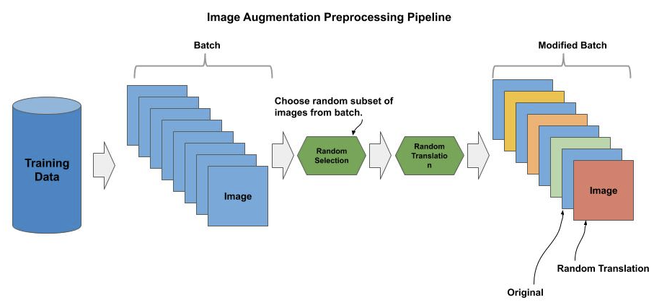
Invariance
Image Augmentation Pipeline
For each batch drawn, a random subset of the images in the batch are selected for augmentation (e.g., 50%)
Then, these randomly selected subset of images are randomly transformed according to some constraints.
The modified batch (originals plus augmented) are then fed to the model for training.

Slide 50
Translation Invariance
Image Augmentation - Translational Invariance
Translational invariance in the context of an image input includes:
Vertical/Horizontal Location (object can be anywhere in the picture)
Rotation (object can be at any rotation).
A vertical/horizontal transformation is typically performed either as a matrix roll operation or crop.
An orientation (e.g., mirror) is typically performed as a matrix flip.
A rotation is typically handled as a matrix transpose.

Slide 51
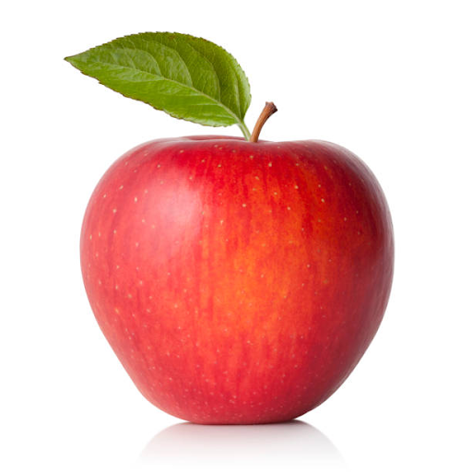
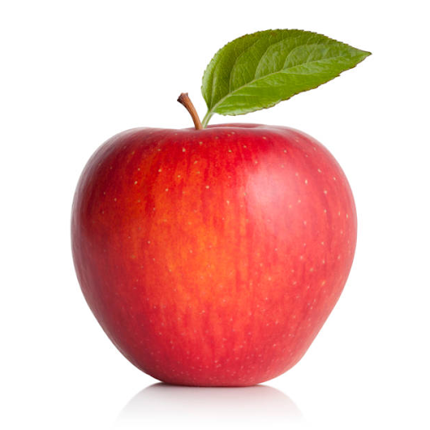
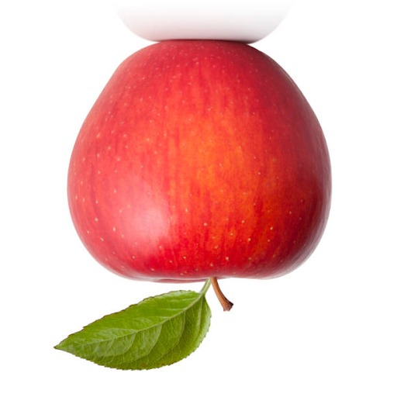
Translation Invariance
Image Augmentation - Flip
A matrix flip transforms an image by flipping an image either on the vertical or horizontal axis. Since the image data is represented as a stack of 2D matrices (i.e., one per channel), A flip can be done efficiently as a matrix transpose function without changes (e.g., interpolation) of the pixel data.
Original - License Vertical Flip Horizontal Flip

Slide 52
Translational Invariance
Flip - PIL
The code example below demonstrates how to flip an image vertically (mirror) and horizontally using a matrix transpose method in Python’s PIL imaging library:
from PIL import Image # read in the image image = Image.open('apple.jpg') # display the image in its original perspective image.show() # flip the image on the vertical axis (mirror) flip = image.transpose(Image.FLIP_LEFT_RIGHT) flip.show() # flip the image on the horizontal axis (upside down) flip = image.transpose(Image.FLIP_TOP_BOTTOM) flip.show()

Slide 53
Translational Invariance
Flip - OpenCV
The code example below demonstrates how to flip an image vertically (mirror) and horizontally using a matrix transpose method in OpenCV:
import cv2 from matplotlib import pyplot as plt # read in the image image = cv2.imread('apple.jpg') # display the image in its original perspective plt.imshow(image) # flip the image on the vertical axis (mirror) flip = cv2.flip(image, 1) plt.imshow(flip) # flip the image on the horizontal axis (upside down) flip = cv2.flip(image, 0) plt.imshow(flip)

Slide 54
Translational Invariance
Flip - Numpy
The code example below demonstrates how to flip an image vertically (mirror) and horizontally using a matrix transpose method in numpy:
import numpy as np import cv2 from matplotlib import pyplot as plt # read in the image image = cv2.imread('apple.jpg') # flip the image on the vertical axis (mirror) flip = np.flip(image, 1) plt.imshow(flip) # flip the image on the horizontal axis (upside down) flip = np.flip(image, 0) plt.imshow(flip)

Slide 55
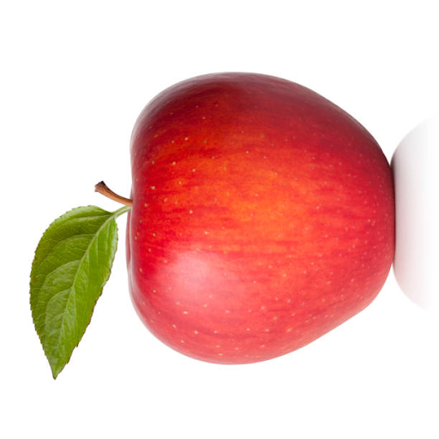
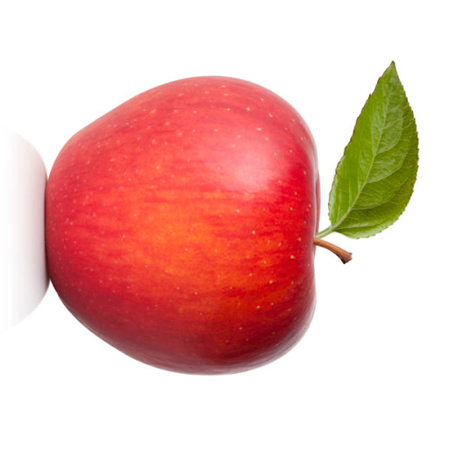
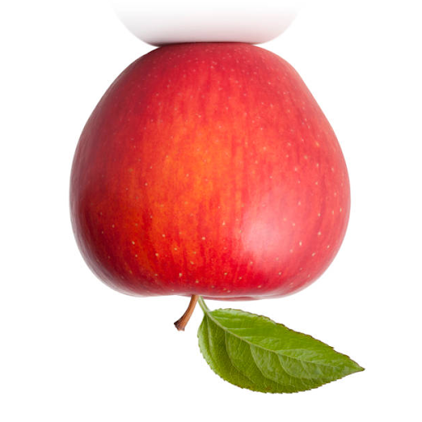
Translational Invariance
Rotate 90/180/270
A matrix transpose operation can be used to rotate an image 90 degrees (left), 180 degrees, and 270 degrees (right).
Like a flip, the operation is very efficient, and does not require interpolation of pixels and does not have a side effect of clipping.
90 180 270

Slide 56
Translational Invariance
Rotate 90/180/270 - PIL
The code example below demonstrates how to rotate an image 90, 180 and 270 degrees using a matrix transpose method in Python’s PIL imaging library:
from PIL import Image # read in the image image = Image.open('apple.jpg') # rotate the image 90 degrees rotate = image.transpose(Image.ROTATE_90) rotate.show() # rotate the image 180 degrees rotate = image.transpose(Image.ROTATE_180) rotate.show() # rotate the image 270 degrees rotate = image.transpose(Image.ROTATE_270) rotate.show()

Slide 57
Translational Invariance
Rotate 90/180/270 - OpenCV
OpenCV does not have a transpose method for 90 or 270 degrees, you can do a 180 by using the flip method with value of -1. All other rotations using OpenCV are demonstrated later using imutils module.
import cv2 from matplotlib import pyplot as plt # read in the image image = cv2.imread('apple.jpg') # rotate the image 180 degrees rotate = cv2.flip(image, -1) plt.imshow(rotate)

Slide 58
Translational Invariance
Rotate 90/180/270 - Numpy
The code example below demonstrates how to rotate an image 90, 180 and 270 degrees using the numpy method rot90(), where the first parameter is the image to rotate 90 degrees and the second parameter (k) is the number of times to perform the rotation:
# read in the image image = cv2.imread('apple.jpg') # rotate the image 90 degrees rotate = np.rot90(image, 1) plt.imshow(rotate) # rotate the image 180 degrees rotate = np.rot90(image, 2) plt.imshow(rotate) # rotate the image 270 degrees rotate = np.rot90(image, 3) plt.imshow(rotate)

Slide 59
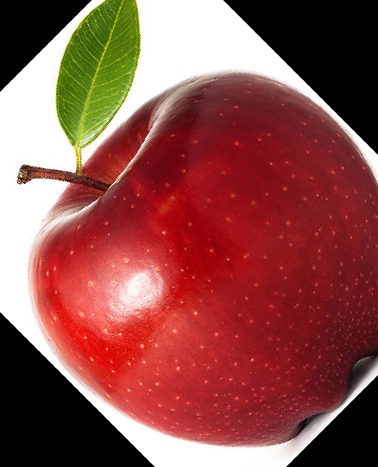
Translational Invariance
Rotation
A rotation transforms an image by rotating the image within -180 and 180 degrees. Generally, the degree of rotation is randomly selected.
If you rotate an image within the same size boundaries, other than 90, 180, or 270, a portion of the edge of the image will end up outside the boundary (i.e., clipped).

Slide 60
Translational Invariance
Rotation
The correct way to handle a rotation is to rotate it within a larger bounding area, such that none of the image is clipped, and then resize the rotated image back to the original size. For this purpose, I recommend using the imutils module (Adrian Rosebrock), which consists of a collection of convenience methods for OpenCV.
import cv2, imutils from matplotlib import pyplot as plt # read in the image image = cv2.imread('apple.jpg') # remember the original Height and Width shape = (image.shape[0], image.shape[1]) # rotate the image rotate = imutils.rotate_bound(image, 45) # resize the image back to its original shape rotate = cv2.resize(rotate, shape, interpolation=cv2.INTER_AREA) plt.imshow(rotate)

Slide 61
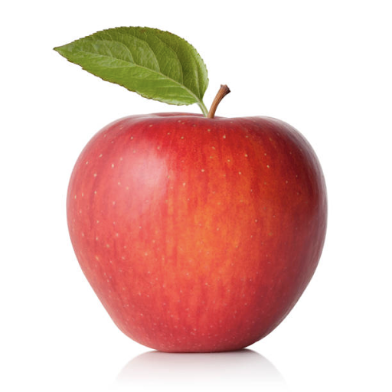
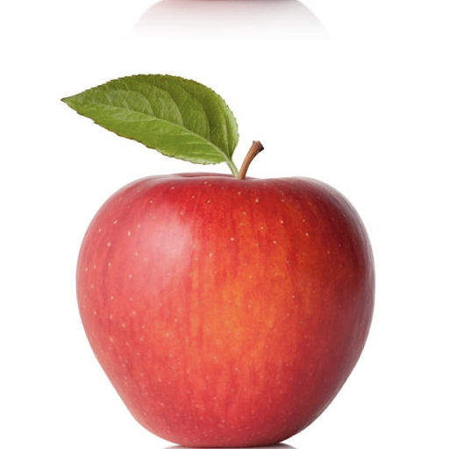
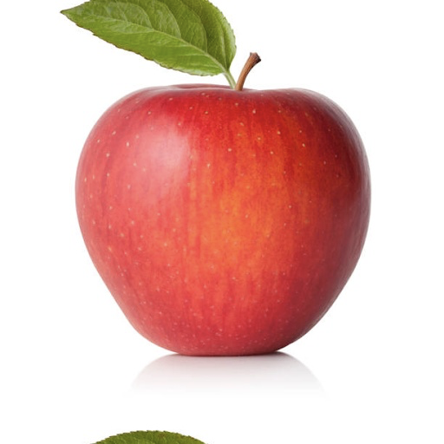
Translational Invariance
Shift
A shift will shift the pixel data in the image +/- in the vertical (height) or horizontal (width) axis. This will change the location in the image of the object being classified.
Original Shifted 10% down Shifted 10% up

Slide 62
Translational Invariance
Shift
The code below demonstrates shifting an image +/- 10% vertically and horizontally using the numpy np.roll() method.
# read in the image image = cv2.imread('apple.jpg') # get the height and width of the image height = image.shape[0] Width = image.shape[1] # shift the image down by 10% roll = np.roll(image, height // 10, axis=0) plt.imshow(roll) # shift the image right by 10% roll = np.roll(image, width // 10, axis=1) plt.imshow(roll)

Slide 63
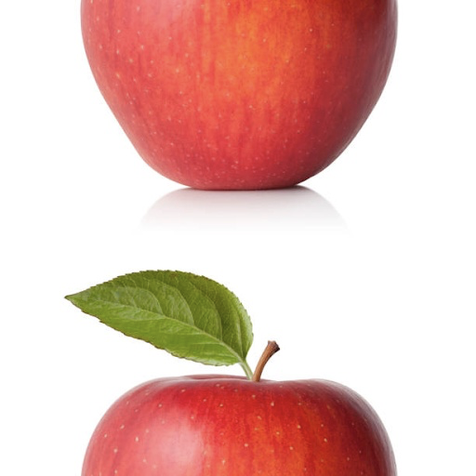
Translational Invariance
Shift - Fractured
the pixels that are shifted off the end are added to the beginning. If the shift is too large, the image can become fractured into two pieces with each piece opposing each other.
A fractured image

Slide 64
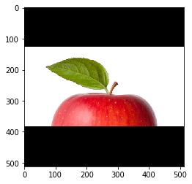
Translational Invariance
Shift - Cropping
To avoid fracture, It is a general practice to limit the shift of the image to no more than 20%. Alternatively, one could do a crop and fill the cutoff space with a black pad, as demonstrated below using OpenCV:

Slide 65
Translational Invariance
Shift - Cropping
Shift and Crop in OpenCV:
image = cv2.imread('apple.png') Image = cv2.cvtColor(image, cv2.COLOR_BGR2RGB) # get the height of the image height = image.shape[0] width = image.shape[1] # Drop the bottom (50%) of the image image = image[0: height//2,:,:] # Make black border to refit the image back to its original size image = cv2.copyMakeBorder(image, (height//4), (height//4), 0, 0, cv2.BORDER_CONSTANT, 0) plt.imshow(image)

Slide 66
Scale Invariance
Image Augmentation - Scale Invariance
Scale invariance in the context of an image input includes:
Zoom (object can be any size in the image)
Affine (object can be viewed from any perspective)

Slide 67
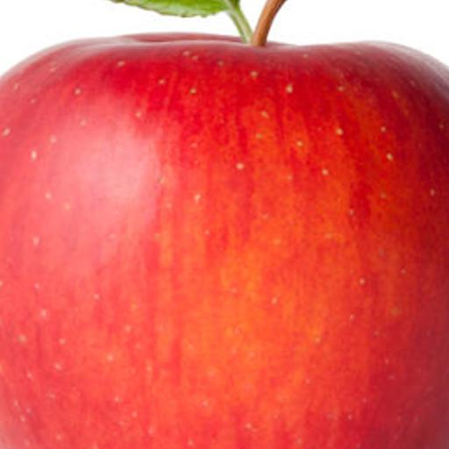
Scale Invariance
Zoom
Zoom transforms an image by zooming in from the center of the image, which is done with a resize and crop operation. First you find the center of the image, calculate the crop bounding box around the center, and then you crop the image. Below is the apple image zoomed by a factor of two:

Slide 68
Scale Invariance
Zoom - PIL
When enlarging an image using Image.resize() the Image.BICUBIC interpolation generally provides the best results.
The code example below demonstrates how to zoom an image using Python’s PIL imaging library:
zoom = 2 # zoom by factor of 2 # remember the original height, width of the image height, width = image.size # resize (scale) the image proportional to the zoom image = image.resize( (int(height*zoom), int(width*zoom)), Image.BICUBIC) # find the center of the scaled image center = (image.size[0]//2, image.size[1]//2) # calculate the crop upper left corner crop = (int(center[0]//zoom), int(center[1]//zoom)) # calculate the crop bounding box box = ( crop[0], crop[1], (center[0] + crop[0]), (center[1] + crop[1]) ) image = image.crop( box ) image.show()

Slide 69
Scale Invariance
Zoom - OpenCV
The code example below demonstrates how to zoom in an image using OpenCV imaging library.
When enlarging an image using cv2.resize() interpolation cv2.INTER_CUBIC generally provides the best results.
zoom = 2 # zoom by a factor of 2 # remember the original height, width of the image height, width = image.shape[:2] # find the center of the scaled image center = (image.shape[0]//2, image.shape[1]//2) z_height = int(height // zoom) z_width = int(width // zoom) # slice (cutout) the zoomed image by forming a crop bounding box image = image[(center[0] - z_height//2):(center[0] + z_height//2), center[1] - z_width//2:(center[1] + z_width//2)] # resize (enlarge) the cropped image back to the original size. image = cv2.resize(image, (width, height), interpolation=cv2.INTER_CUBIC) plt.imshow(image)

Slide 70
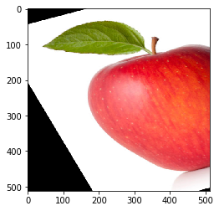
Scale Invariance
Affine
Performing an affine transformation to change the viewing perspective is an advanced task, beyond the scope of this section. We will give a basic example and recommend to readers wanting more detail to view tutorials specific to affine transformations in OpenCV.

Slide 71
Scale Invariance
Affine - OpenCV
The previous example is produced by this code in OpenCV:
image = cv2.imread('apple.png') image = cv2.cvtColor(image, cv2.COLOR_BGR2RGB) rows,cols,ch = image.shape # set of points for warping the perspective pts1 = np.float32([[50,50],[200,50],[50,200]]) pts2 = np.float32([[10,100],[200,50],[100,250]]) # get the corresponding transformation matrix matrix = cv2.getAffineTransform(pts1, pts2) # Warp the perspective image = cv2.warpAffine(image, matrix, (cols, rows)) plt.imshow(image)

Slide 72
Invariance - Generator
TF.Keras - ImageDataGenerator
The TF.Keras image preprocessing module supports a wide variety of image augmentation with the class ImageDataGenerator.
The ImageDataGenerator class creates a generator for generating batches of augmented images.
Below are a few of the parameters, which we will cover in this section:
horizontal_flip=True|False
vertical_flip=True|False
rotation_range=degrees
zoom_range=(lower, upper)
width_shift_range=percent
height_shift_range=percent
brightness_range=(lower, upper)

Slide 73
Invariance - ImageDataGenerator
ImageDataGenerator - Instantiation
Read in a single image of an apple.
Create a batch of one image (the apple).
Instantiate an ImageDataGenerator object.
Initialize the ImageDataGenerator with our augmentation options (in this case: horizontal and vertical flip).
from tensorflow.keras.preprocessing.image import ImageDataGenerator import cv2 import numpy as np from matplotlib import pyplot as plt # Let's make a batch of 1 image (apple) image = cv2.imread('apple.jpg') batch = np.asarray([image]) # Create a data generator for augmenting the data datagen = ImageDataGenerator(horizontal_flip=True, vertical_flip=True)

Slide 74
Invariance - ImageDataGenerator
ImageDataGenerator - Generation
Use the flow() method of the ImageDataGenerator method to create a batch generator.
Iterate through the generator 6 times, each time returning a batch of 1 image in x.
The generator will randomly select an augmentation (including no augmentation) per iteration.
After transformation (augmentation), the pixel values will be 32-bit float.
Change the data type of the pixels back to 8-bit integer, for displaying using matplotlib.
# Let's run the generator, where every image is a random augmentation step=0 for x in datagen.flow(batch, batch_size=1): step += 1 if step > 6: break plt.figure() # the augmentation operation will change the pixel data to float # change it back to uint8 for displaying the image plt.imshow(x[0].astype(np.uint8))

Slide 75
Invariance - ImageDataGenerator
ImageDataGenerator - Generation
Rotation
Zoom
Shift
Brightness
datagen = ImageDataGenerator(rotation_range=60)
datagen = ImageDataGenerator(zoom_range=(0.5, 2))
datagen = ImageDataGenerator(width_shift_range=0.2, height_shift_range=0.2)
datagen = ImageDataGenerator(brightness_range=(0.5, 2))

Slide 76
Raw (Disk) Datasets
Production Datasets
Beyond the curated datasets used for academic/research purposes, the datasets one would use in production are likely stored on disk (or database if structured data). In the case of image data, one will need to:
Read images and corresponding labels from disk into memory (assumes image data fits into memory).
Resize the images to match the input vector of the convolutional neural network.

Slide 77
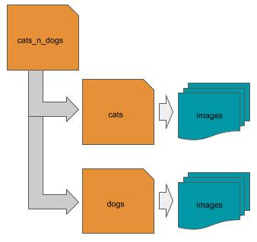
Raw (Disk) Datasets
Directory Structure
Laying out (placing) the images into a directory folder structure on a local disk is one of the most common layouts.
The root (parent) folder is a container for the dataset.
Below the root level are one or more subdirectories, where each subdirectory corresponds to a class (label), and
Where each subdirectory contains the images that correspond to that class.

Slide 78
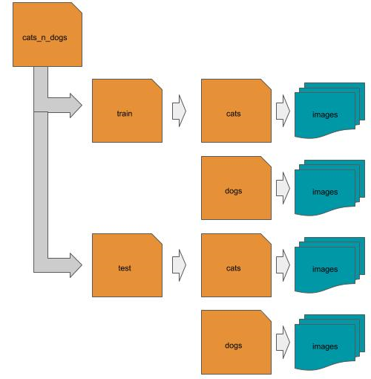
Raw (Disk) Datasets
Directory Structure - Dataset Split
If the dataset has been pre-split into training and test data (explained subsequently), then first group the data by train/test, then group the data group the data by the two classes for cats and dogs. You can further subgroup the data by breed or other characteristics.

Slide 79
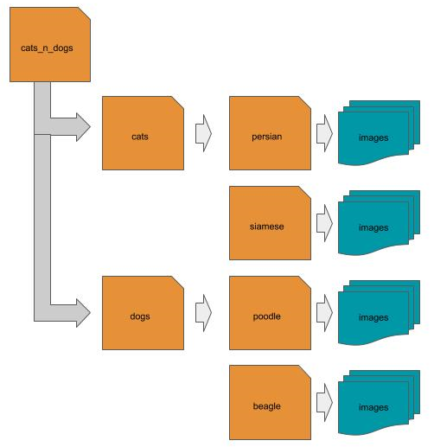
Raw (Disk) Datasets
Directory Structure - Hierarchical
When the dataset is hierarchically labeled, each top-level class (label) subfolder is further partitioned into child-subfolders according to the class (label) hierarchy.

Slide 80
Raw (Disk) Datasets
CSV File
Another common layout is to use a CSV file to identify the location and class (label) of each image.
Each row in the CSV file is a separate image, and
The CSV file contains at least two columns, one for the location of the image, and the other for the class (label) of the image.
local path example:
label,location ‘cat’, cats_n_dogs/cat/1.jpg ‘dog’,cats_n_dogs/dog/2.jpg …
remote path example: label,location ‘cat’,’http://mysite.com/cats_n_dogs/cat/1.jpg’ ‘dog’,’http://mysite.com/cats_n_dogs/dog/2.jpg’

Slide 81
Raw (Disk) Datasets
JSON File
Another common layout is to use a JSON file to identify the location and class (label) of each image.
The JSON file is an array of objects,
Where each object is a separate image,
Each object has at least two keys, one for the location of the image, and the other for the class (label) of the image.
local path example:
[ {‘label’: ‘cat’, ‘location’: ‘cats_n_dogs/cat/1.jpg’ }, {‘label’: ‘dog’, ‘location’: ‘cats_n_dogs/dog/2.jpg’} … ]

Slide 82
Reading Images
Reading Image from Disk - PIL
The first step is to read an image from disk into memory. The image on disk will be in an image format like JPG, PNG, TIF, etc. These formats define how the image is encoded and compressed for storage. An image can be read into memory using the PIL Image.open() method.
In OpenCV using cv2.imread() method:
from PIL import Image image = Image.open('myimage.jpg')
import cv2 image = cv2.imread('myimage.jpg')

Slide 83
Reading Images
Reading Images from a Subdirectory - PIL
You will have a large number of images that need to be read in. Let’s assume you want to read in all the images under some subdirectory (e.g., cats).
In the code below, we scan (get list of) all the files in the subdirectory, read each one in as an image, and maintain a list of the read-in images as a list:
def loadImages(subdir): images = [] # get list of all files in subdirectory cats files = os.scandir(subdir) # read each image in and append the in-memory image to a list for file in files: images.append(Image.open(file.path)) return images loadImages('cats')
Note, os.scandir() was added in Python 3.5. If you are using Python 2.7 or an earlier version of Python 3, you can obtain a compatible version with pip install scandir.

Slide 84
Reading Images
Reading Images from Directory Structure
Let’s expand on the previous and assume the image dataset is laid out as a directory structure, where each subdirectory is a class (label). In this case, we would want to scan each subdirectory separately, and keep a record of the subdirectory names for the classes.
def loadDirectory(parent): classes = {} # list of class to label mappings dataset = [] # list of images by class # get list of all subdirectories under the parent (root) directory of the dataset for subdir in os.scandir(parent): # ignore any entry that is not a subdirectory (e.g., license file) if not subdir.is_dir(): continue # maintain mapping of class (subdirectory name) to label (index) classes[subdir.name] = len(dataset) # maintain list of images by class dataset.append(loadImages(subdir.path)) print("Processed:", subdir.name, "# Images", len(dataset[len(dataset)-1])) return dataset, classes loadDirectory('cats_n_dogs')

Slide 85
Reading Images
Reading Remote Images - PIL
Let’s try an example where the location of the image is remote (not local) and specified by an URL.
We will need to make an HTTP request for the contents of the resource (image) specified by the URL
Then decode the response into a binary byte stream.
from PIL import Image import requests from io import BytesIO def remoteImage(url): try: response = requests.get(url) return Image.open(BytesIO(response.content)) except: return None

Slide 86
Reading Images
Reading Remote Images - OpenCV
Let’s try an example where the location of the image is remote (not local) and specified by an URL in OpenCV:
try: response = requests.get(url) if channel == 1: return cv2.imdecode(BytesIO(response.content), cv2.IMREAD_GRAYSCALE) else: return cv2.imdecode(BytesIO(response.content), cv2.IMREAD_COLOR) except: return None

Slide 87
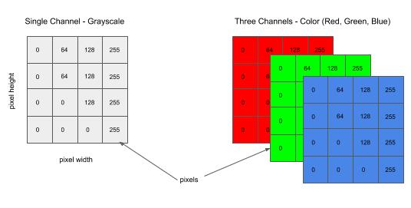
Reading Images
Channel Conversion
We need to set the number of channels to match the input shape of your neural network.
The number of channels is the number of color planes in your image:
Grayscale image will have one color channel.
RGB color image will have three color channels, one for each of Red, Green and Blue.

Slide 88
Reading Images
RGBA images
The Image.open() method will read in the image according to the number of channels in the image stored on disk.
Grayscale image, it will read it in as a single channel,
RGB it will read it in as three channels
RGBA (+alpha channel), it will read it in as 4 channels.
In general when working with RGBA images, the alpha channel can be dropped.
It is a mask for setting the transparency of each pixel in the image, and therefore does not
contain information that would otherwise contribute to the recognition of the image.

Slide 89
Reading Images
Channel Conversion - PIL
If the neural network takes grayscale images (single channel), we want to convert to grayscale; or if the neural network takes RGB images (three channel), we want to convert to RGB. The convert() method will do channel conversion. A parameter value of ‘L’ will convert to single channel (grayscale) and ‘RGB’ to three channels (RGB color).
def loadImages(subdir, channels): images = [] # get list of all files in subdirectory cats files = os.scandir(subdir) # read each image in and append the in-memory image to a list for file in files: image = Image.open(file.path) # convert to grayscale if channels == 1: image = image.convert('L') # convert to RGB color else: image = image.convert('RGB') images.append(image) return images loadImages('cats', 3)

Slide 90
Reading Images
Channel Conversion - OpenCV
Another advantage of OpenCV over PIL is that you can do the channel conversion at the time of reading in the image, instead of a second step. By default, cv2.imread() will convert the image to a three channel RGB image. You can specify a second parameter that indicates which channel conversion to use.
# read in image as a single channel (grayscale) image if channel == 1: image = cv2.imread('myimage.jpg', cv2.IMREAD_GRAYSCALE) # read in image as a three channel (color) image else: image = cv2.imread('myimage.jpg', cv2.IMREAD_COLOR)

Slide 91
Resizing Images
Resizing Images
We need to resize each image to fit the shape of the input shape of the neural network.
For example, if the input shape is (128, 128, 3), then we want to resize the height and width of each image to (128, 128). The resize() method will do the resizing.
In most cases, you will be downsizing (i.e., downsampling) each image. For example, an 1024 x 768 image will be 3Mb in size. This is far more resolution than a neural network needs (see section on Convolutional Neural Networks).

Slide 92
Resizing Images
Resizing Images - PIL
When the image is downsized, some resolution (details) will be lost. To minimize the effect when downsizing, it is a common practice to use the anti-aliasing algorithm in PIL.
def loadImages(subdir, channels, shape): images = [] # get list of all files in subdirectory cats files = os.scandir(subdir) # read each image in and append the in-memory image to a list for file in files: image = Image.open(file.path) # convert to grayscale if channels == 1: image = image.convert('L') # convert to RGB color else: image = image.convert('RGB') # resize the image to the target input shape images.append(image.resize(shape, Image.ANTIALIAS)) # convert all the PIL images to numpy arrays in a single invocation return np.asarray(images) loadImages('cats', 3, (128, 128))

Slide 93
Resizing Images
Resizing Images - OpenCV
Images are resized using the cv2.resize() method. The second parameter is a tuple of the height and width to resize the image to. The optional (keyword) third parameter is the interpolation algorithm to use when resizing.
Since in most cases you will be downsampling, the common practice is to use the cv2.INTER_AREA algorithm for best results in preserving information and minimizing artifacts when downsampling an image.
# resize an image to 128 (height) x 128 (width) image = cv2.resize(image, (128, 128), interpolation=cv2.INTER_AREA)

Slide 94
Save/Restore Models
Model Saving
We can save both the model and the trained parameters (i.e., weights and biases). The model and weights can be saved separately or together.
The save() method will save both the weights/biases and the model to a specified folder in Tensorflow SavedModel format.
# Train a model model.fit(x_train, y_train, epochs=epochs, batch_size=batch_size) # Save the model and trained weights and biases. model.save('mymodel')

Slide 95
Save/Restore Models
Model Saving - Weights Only
The trained weights/biases and the model can be saved separately. The save_weights() method will save the model’s parameters only to the specified folder in Tensorflow Checkpoint format.
# Train a model model.fit(x_train, y_train, epochs=epochs, batch_size=batch_size) # Save the trained weights and biases only. model.save_weights('myweights')

Slide 96
Save/Restore Models
Model Restoring
We can restore a model architecture and/or the model parameters (i.e., weights and biases).
Restoring a model architecture is generally done for loading a pre-built model,
While loading both the model architecture and model parameters is generally done for transfer learning.
from tensorflow.keras.models import load_model # load a pre-trained model model = load_model('mymodel')
from tensorflow.keras.models import load_weights # load a pre-built model model = load_model('mymodel') # load pre-trained weights for the model model.load_weights('myweights')

Slide 97
Training Foundation - Lab Exercise #3
Optional Code Lab - Get Familiar with Training
Deep Learning by Design - Workshop - Chapter 3 - 1.ipynb
Deep Learning by Design - Workshop - Chapter 3 - 2.ipynb

